Slide 1
Autonomous Robot with Obstacle Avoidance and Auto Parking

Slide 2

Objective
To design and implement a robot that can autonomously navigate, avoid obstacles, and park itself.
Modes of Operation
Obstacle Avoidance Mode

Slide 3
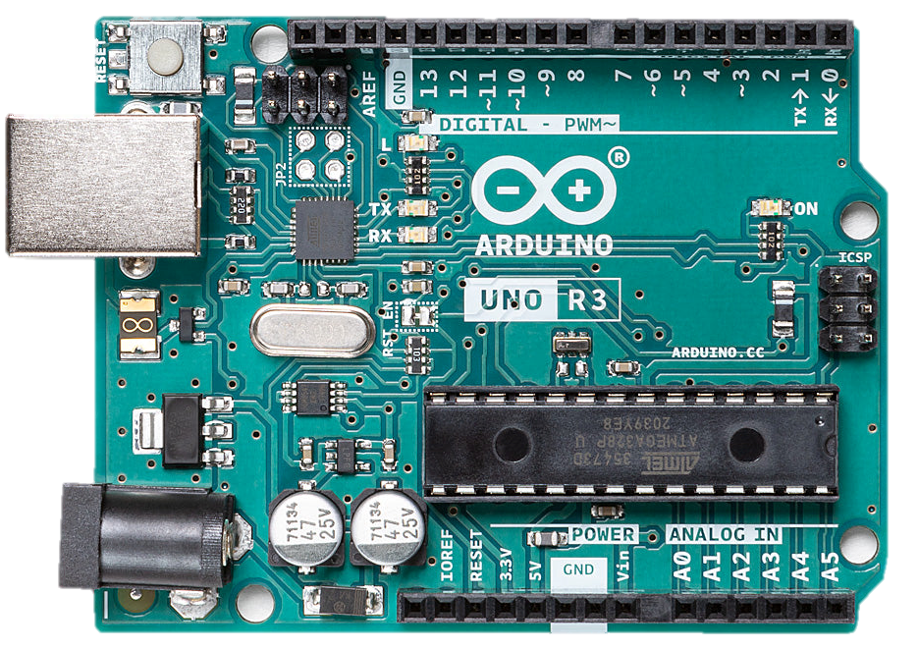
Problem Statement
Challenges
1
1
Design a robot capable of autonomous navigation in dynamic environments.
Dynamic obstacle detection and avoidance.
Problem Description
2
2
Challenges include reliable obstacle detection, avoidance.
Accurate identification within designated spaces.

Slide 4
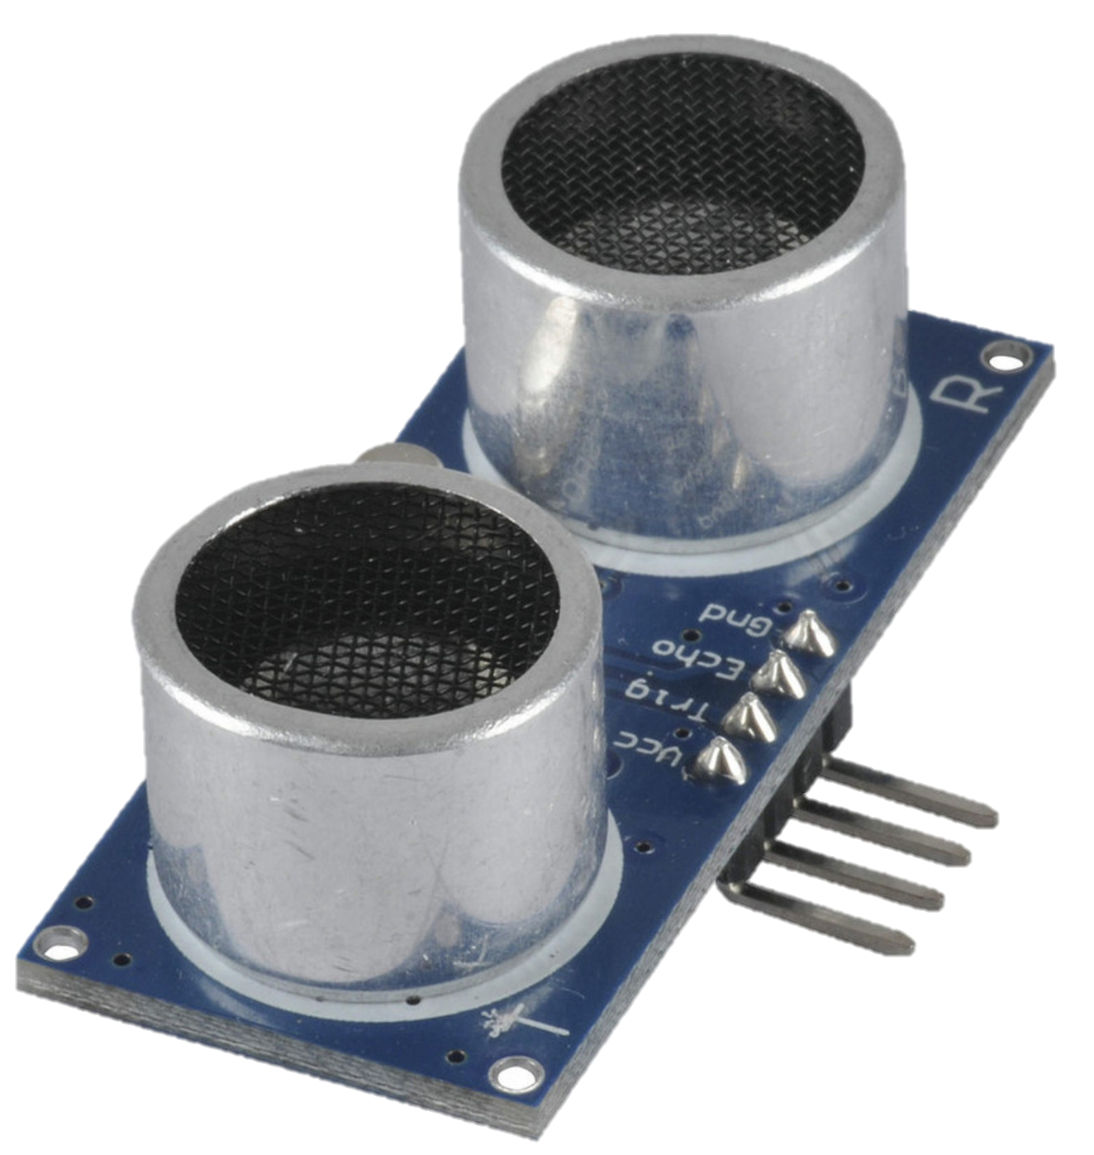
Problem Statement
Challenges
Components
1
1
Design a robot capable of autonomous navigation in dynamic environments.
Dynamic obstacle detection and avoidance.
Arduino Uno:
The brain of the system, responsible for sensor data processing, decision-making, and control algorithms.
2
2
Challenges include reliable obstacle detection, avoidance, and precise parking.
Accurate identification and parking within designated spaces.
Ultrasonic Sensors: We used one ultrasonic sensor to measure distances to avoid obstacles.

Slide 5
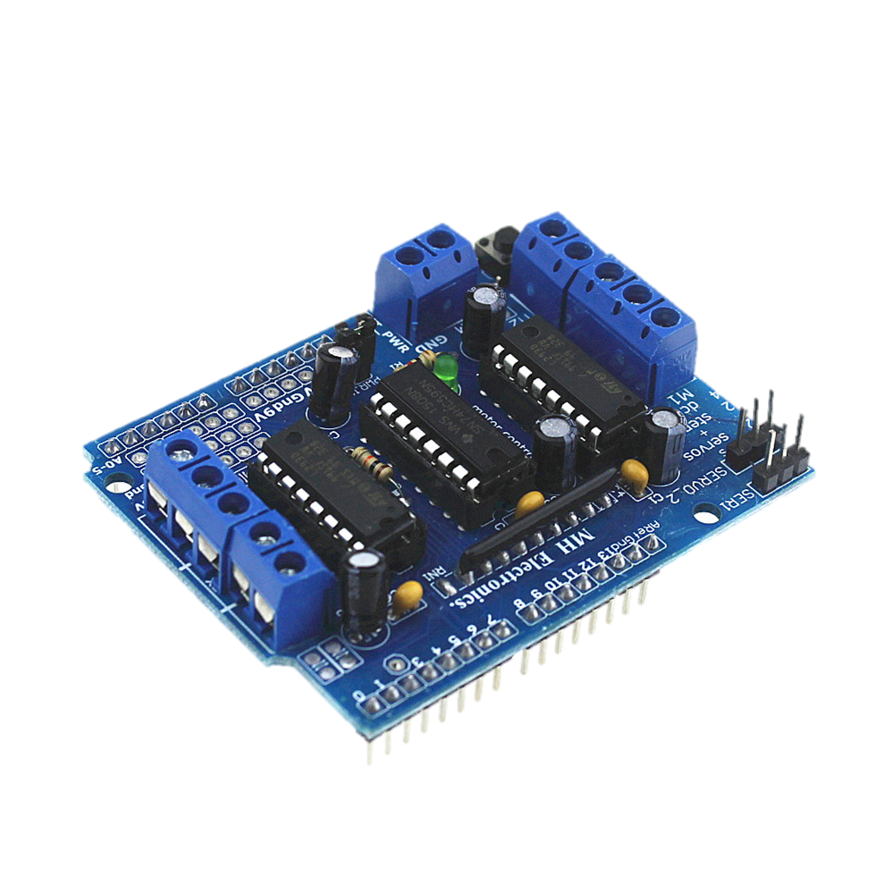
Components
1
1
Ultrasonic Sensors: We used one ultrasonic sensor to measure distances to avoid obstacles.
2
Arduino Uno:
The brain of the system, responsible for sensor data processing, decision-making, and control algorithms.

Slide 6
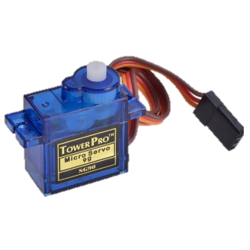
Components
1
1
Motor Drive:
The electronic device that controls the power supplied to the DC motor, ensuring it follows the commands from the control system based on feedback.
Ultrasonic Sensors: We used one ultrasonic sensor to measure distances to avoid obstacles.
2

Slide 7
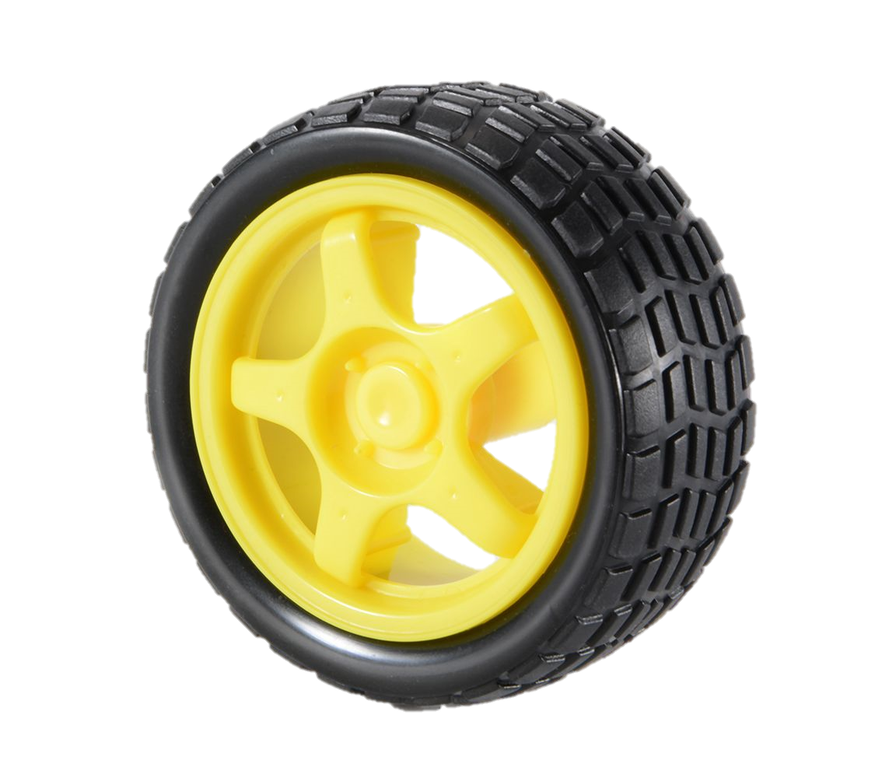
Components
1
1
Servo Motor:
Controls the steering mechanism of any other movable parts, and it adjusts the direction of the ultrasonic sensor for better obstacle detection.
2
Motor Drive:
The electronic device that controls the power supplied to the DC motor, ensuring it follows the commands from the control system based on feedback.

Slide 8
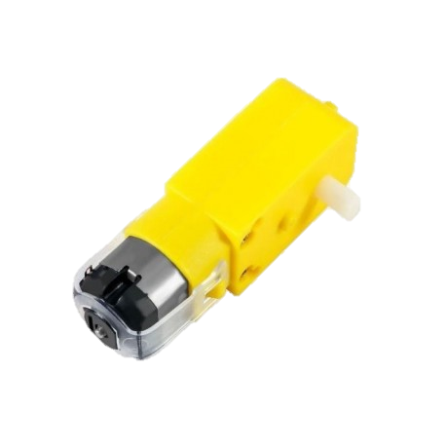
Components
1
Wheels:
We used 4 rubber wheels , Each wheel is attached to a DC motor.
1
2
Servo Motor:
Controls the steering mechanism of any other movable parts, and it adjusts the direction of the ultrasonic sensor for better obstacle detection.

Slide 9
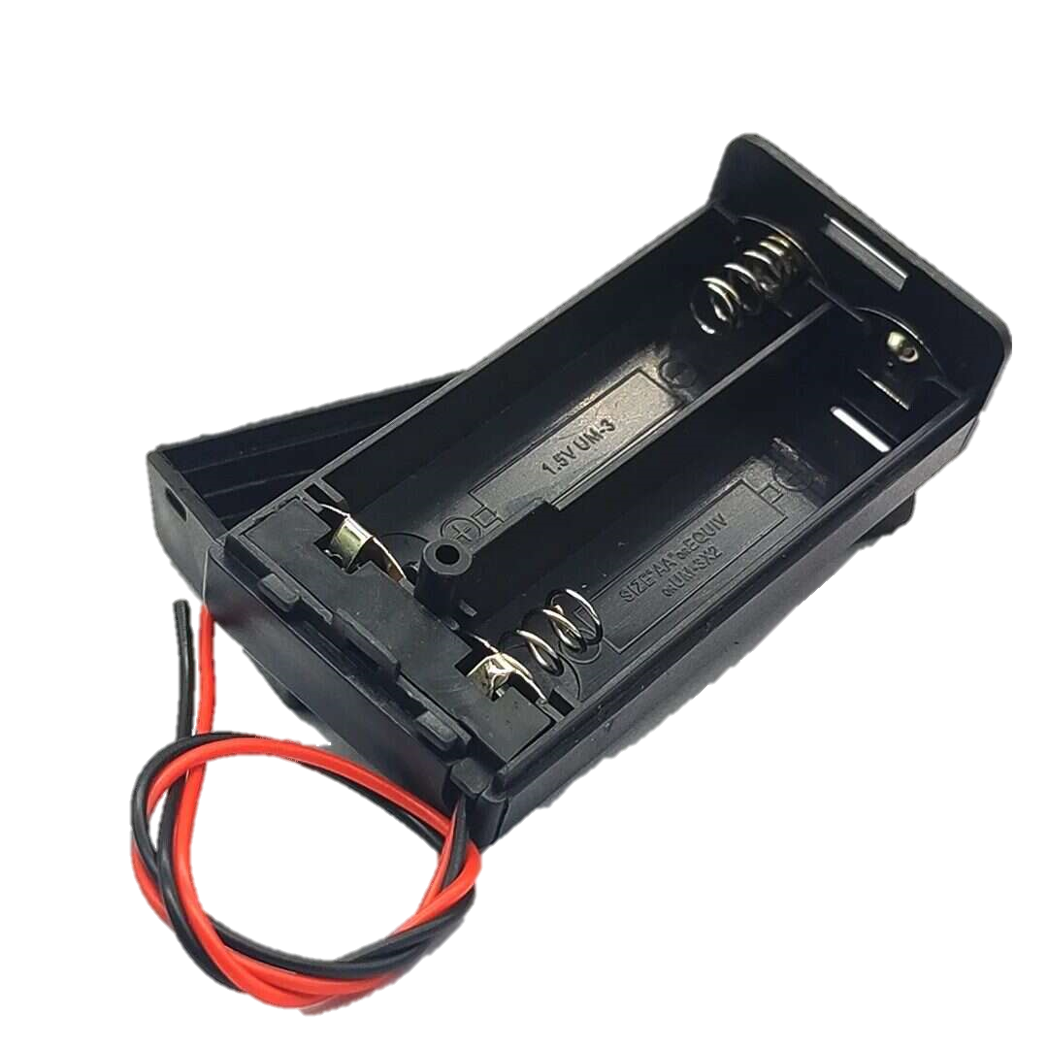
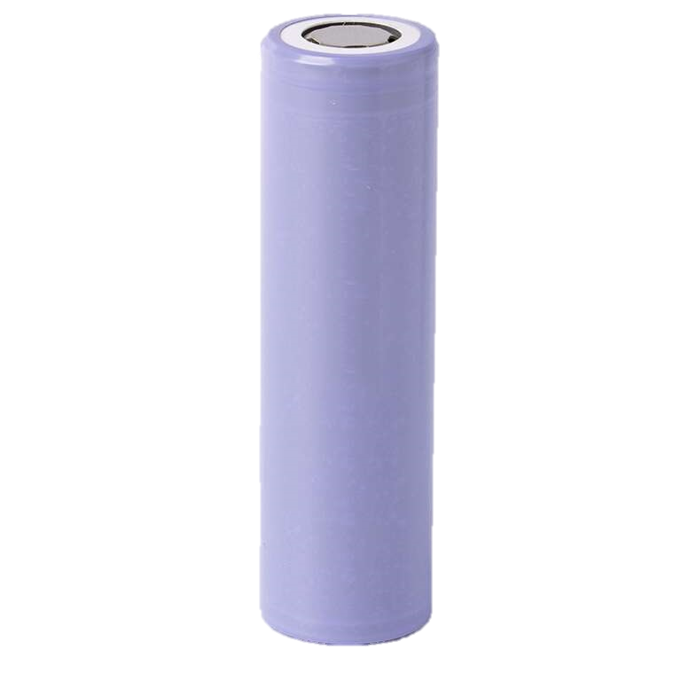
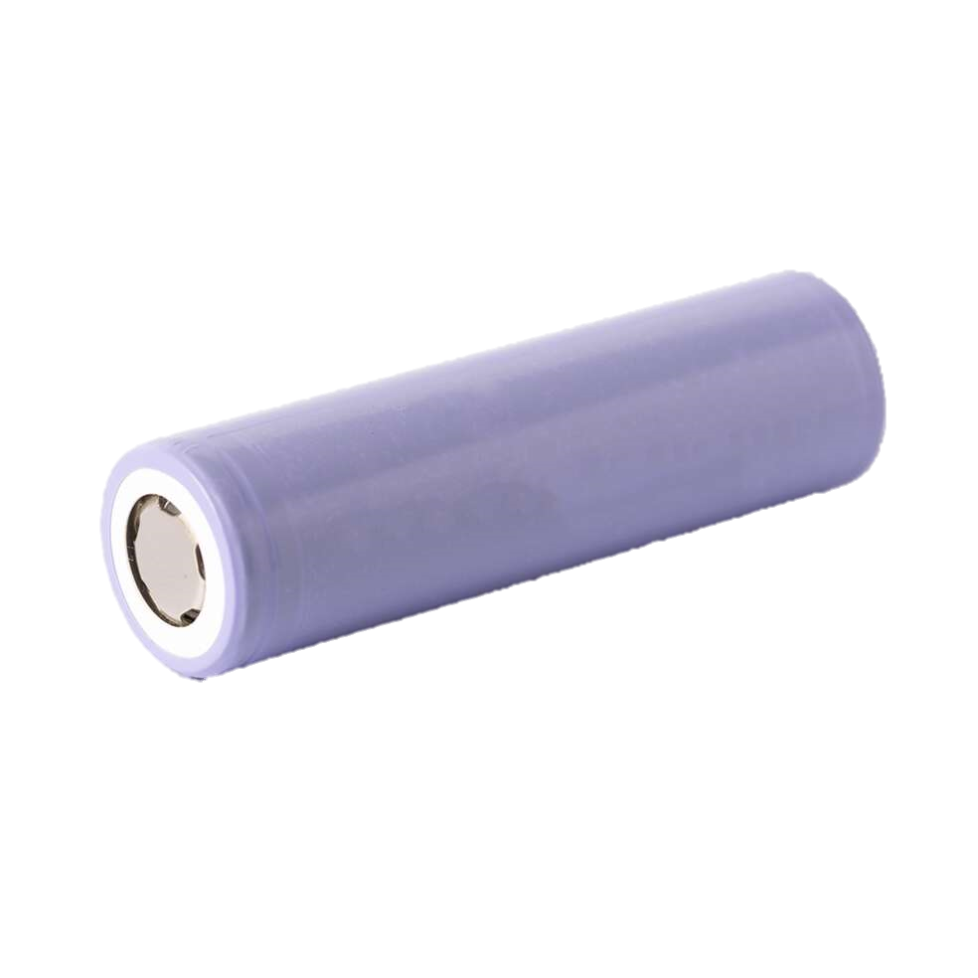
Components
1
1
Wheels:
We used 4 rubber wheels , Each wheel is attached to a DC motor.
DC Motor (4): They Provide the driving force for the robot's wheels, allowing it to move forward, backward, and turn.
2

Slide 10
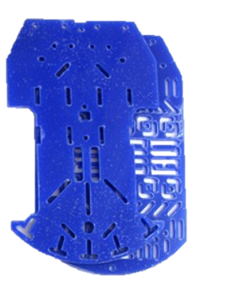
Components
1
1
Power Supply: We used a battery pack with 2 batteries, 3.7V each , it supplies power to the Arduino, motors, and other electronic components.
2
DC Motor (4): They Provide the driving force for the robot's wheels, allowing it to move forward, backward, and turn.

Slide 11
Components
1
1
Power Supply: We used a battery pack with 2 batteries, 3.7V each , it supplies power to the Arduino, motors, and other electronic components.
Robot Platform: We used a 26 x 15 cm robot platform to provide a stable structure to mount all the components and support the overall integrity of the robot.
2

Slide 12
Interaction
Robot Platform: We used a 26 x 15 cm robot platform to provide a stable structure to mount all the components and support the overall integrity of the robot.
Sensors detect obstacles.
Microcontroller processes sensor data and controls motors.
Software algorithms dictate navigation .

Slide 13
Algorithms Chosen
Obstacle Avoidance System
Sensors for Obstacle Detection
Working Principle
Ultrasonic Sensors: Emit sound waves and measure the time taken for the echo to return to calculate distance.
Continuously scan for obstacles.
Calculate distance and determine if the path is clear.
Navigate around detected obstacles.

Slide 14
Algorithms Chosen
Obstacle Avoidance System
Description: This algorithm continuously checks the distance to the nearest obstacle and makes decisions to avoid collisions.
Steps:
Measure the distance to the nearest obstacle using the ultrasonic sensor.
If an obstacle is detected within a threshold distance (15 cm in this case), the car stops.
The car moves backward for a short duration to create space.
The car stops and measures the distance to the right and left by rotating the servo.
The car turns in the direction where more space is available.
If no obstacle is detected within the threshold, the car continues moving forward.
Sensors for Obstacle Detection
01
02
Distance Measurement Algorithm
Ultrasonic Sensors: Emit sound waves and measure the time taken for the echo to return to calculate distance.
Infrared Sensors:
Measure reflected IR light to detect nearby objects.
Obstacle Detection and Response Algorithm
04
03
Servo Positioning Algorithms
Movement Control Algorithms
Working Principle
Continuously scan for obstacles.
Calculate distance and determine if the path is clear.
Navigate around detected obstacles.

Slide 15
Algorithms Chosen
Obstacle Detection and Response Algorithm
Obstacle Avoidance System
Description: This algorithm continuously checks the distance to the nearest obstacle and makes decisions to avoid collisions.
Steps:
Measure the distance to the nearest obstacle using the ultrasonic sensor.
If an obstacle is detected within a threshold distance (15 cm in this case), the car stops.
The car moves backward for a short duration to create space.
The car stops and measures the distance to the right and left by rotating the servo.
The car turns in the direction where more space is available.
If no obstacle is detected within the threshold, the car continues moving forward.
Sensors for Obstacle Detection
Description: This algorithm uses an ultrasonic sensor to measure the distance to an object.
Steps:
Trigger the ultrasonic sensor to send a pulse.
Measure the time taken for the echo to return.
Convert the time into a distance measurement (in centimeters).
Return the measured distance. If no echo is received (distance is 0), return a default large distance (250 cm).
01
02
Distance Measurement Algorithm
Ultrasonic Sensors: Emit sound waves and measure the time taken for the echo to return to calculate distance.
Infrared Sensors:
Measure reflected IR light to detect nearby objects.
04
03
Servo Positioning Algorithms
Movement Control Algorithms
Working Principle
Continuously scan for obstacles.
Calculate distance and determine if the path is clear.
Navigate around detected obstacles.

Slide 16
Algorithms Chosen
Distance Measurement Algorithm
Obstacle Avoidance System
Description: This algorithm continuously checks the distance to the nearest obstacle and makes decisions to avoid collisions.
Steps:
Measure the distance to the nearest obstacle using the ultrasonic sensor.
If an obstacle is detected within a threshold distance (15 cm in this case), the car stops.
The car moves backward for a short duration to create space.
The car stops and measures the distance to the right and left by rotating the servo.
The car turns in the direction where more space is available.
If no obstacle is detected within the threshold, the car continues moving forward.
Description: This algorithm uses an ultrasonic sensor to measure the distance to an object.
Steps:
Trigger the ultrasonic sensor to send a pulse.
Measure the time taken for the echo to return.
Convert the time into a distance measurement (in centimeters).
Return the measured distance. If no echo is received (distance is 0), return a default large distance (250 cm).
Obstacle Detection and Response Algorithm
01
02
Description: When starting forward or backward movement, the speed of the motors is gradually increased to avoid sudden power surges that could drain the battery quickly.
Steps:
Start the motors in the desired direction (forward or backward).
Gradually increase the motor speed in increments until the maximum speed is reached.
04
03
Servo Positioning Algorithms
Movement Control Algorithms
Working Principle
Continuously scan for obstacles.
Calculate distance and determine if the path is clear.
Navigate around detected obstacles.

Slide 17
Algorithms Chosen
Obstacle Avoidance System
Description: This algorithm uses an ultrasonic sensor to measure the distance to an object.
Steps:
Trigger the ultrasonic sensor to send a pulse.
Measure the time taken for the echo to return.
Convert the time into a distance measurement (in centimeters).
Return the measured distance. If no echo is received (distance is 0), return a default large distance (250 cm).
Distance Measurement Algorithm
Obstacle Detection and Response Algorithm
01
02
Description: When starting forward or backward movement, the speed of the motors is gradually increased to avoid sudden power surges that could drain the battery quickly.
Steps:
Start the motors in the desired direction (forward or backward).
Gradually increase the motor speed in increments until the maximum speed is reached.
Description: This algorithm positions the servo motor to direct the ultrasonic sensor to look right or left and measure the distance.
Steps:
Move the servo to a predefined angle (right or left).
Wait for the servo to reach the position.
Measure the distance using the ultrasonic sensor.
Return the servo to the center position.
04
03
Servo Positioning Algorithms
Movement Control Algorithms
Working Principle
Continuously scan for obstacles.
Calculate distance and determine if the path is clear.
Navigate around detected obstacles.

Slide 18
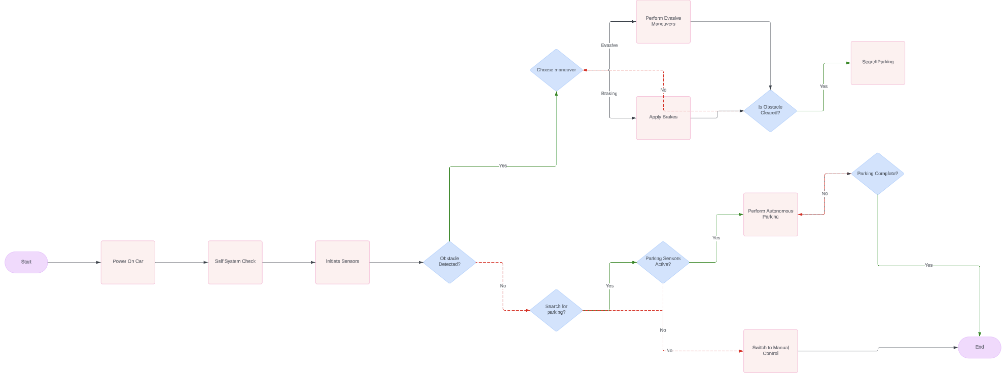
FlowChart
Algorithms Chosen
Obstacle Avoidance System
Description: This algorithm uses an ultrasonic sensor to measure the distance to an object.
Steps:
Trigger the ultrasonic sensor to send a pulse.
Measure the time taken for the echo to return.
Convert the time into a distance measurement (in centimeters).
Return the measured distance. If no echo is received (distance is 0), return a default large distance (250 cm).
Obstacle Detection and Response Algorithm
01
02
Distance Measurement Algorithm
Description: When starting forward or backward movement, the speed of the motors is gradually increased to avoid sudden power surges that could drain the battery quickly.
Steps:
Start the motors in the desired direction (forward or backward).
Gradually increase the motor speed in increments until the maximum speed is reached.
Description: This algorithm positions the servo motor to direct the ultrasonic sensor to look right or left and measure the distance.
Steps:
Move the servo to a predefined angle (right or left).
Wait for the servo to reach the position.
Measure the distance using the ultrasonic sensor.
Return the servo to the center position.
04
03
Movement Control Algorithms
Servo Positioning Algorithms
Continuously scan for obstacles.
Calculate distance and determine if the path is clear.
Navigate around detected obstacles.

Slide 19
Algorithms Chosen
The primary algorithms used in the code can be summarized as:
Obstacle Detection and Avoidance: Continuously checks for obstacles and makes decisions to avoid collisions.
Distance Measurement: Uses the ultrasonic sensor to measure distances and determines if there is an obstacle.
Movement Control:
Gradual Speed Increase: Gradually increases the motor speed to the desired level.
Directional Turning: Controls the direction of the car by turning right or left.
Servo Positioning: Positions the servo to look right or left and measure distances to aid in decision-making.
These algorithms work together to enable the car to navigate its environment autonomously, avoiding obstacles and making decisions to move in the safest direction.
FlowChart
Obstacle Detection and Response Algorithm
Distance Measurement Algorithm
Description: This algorithm positions the servo motor to direct the ultrasonic sensor to look right or left and measure the distance.
Steps:
Move the servo to a predefined angle (right or left).
Wait for the servo to reach the position.
Measure the distance using the ultrasonic sensor.
Return the servo to the center position.
Movement Control Algorithms
Code Implementation summary
Servo Positioning Algorithms
01
02
04
03

Slide 20
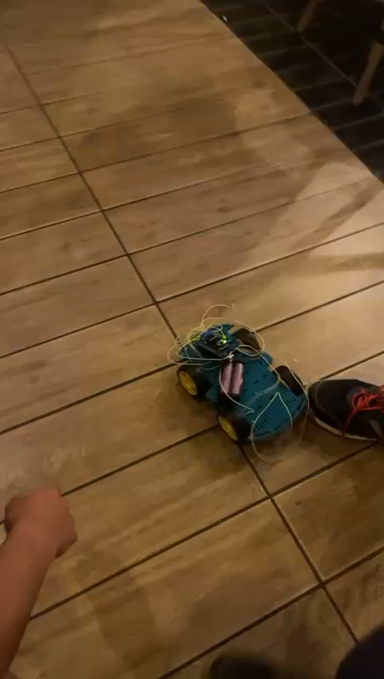
The primary algorithms used in the code can be summarized as:
Obstacle Detection and Avoidance: Continuously checks for obstacles and makes decisions to avoid collisions.
Distance Measurement: Uses the ultrasonic sensor to measure distances and determines if there is an obstacle.
Movement Control:
Gradual Speed Increase: Gradually increases the motor speed to the desired level.
Directional Turning: Controls the direction of the car by turning right or left.
Servo Positioning: Positions the servo to look right or left and measure distances to aid in decision-making.
These algorithms work together to enable the car to navigate its environment autonomously, avoiding obstacles and making decisions to move in the safest direction.
FlowChart
Code Implementation summary

Slide 21
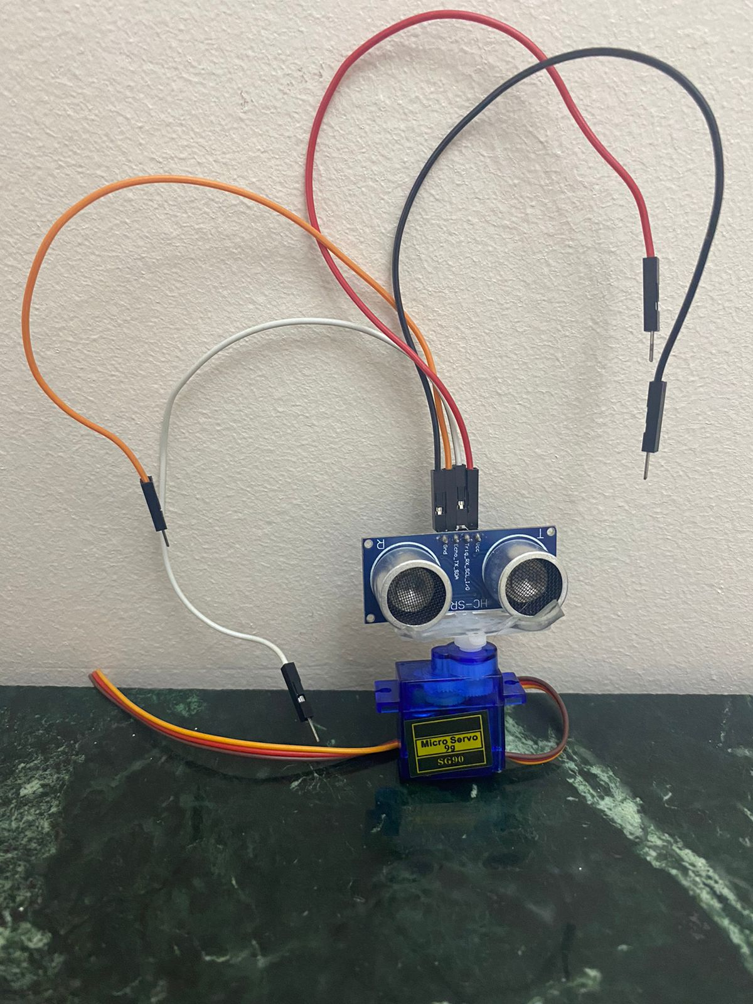
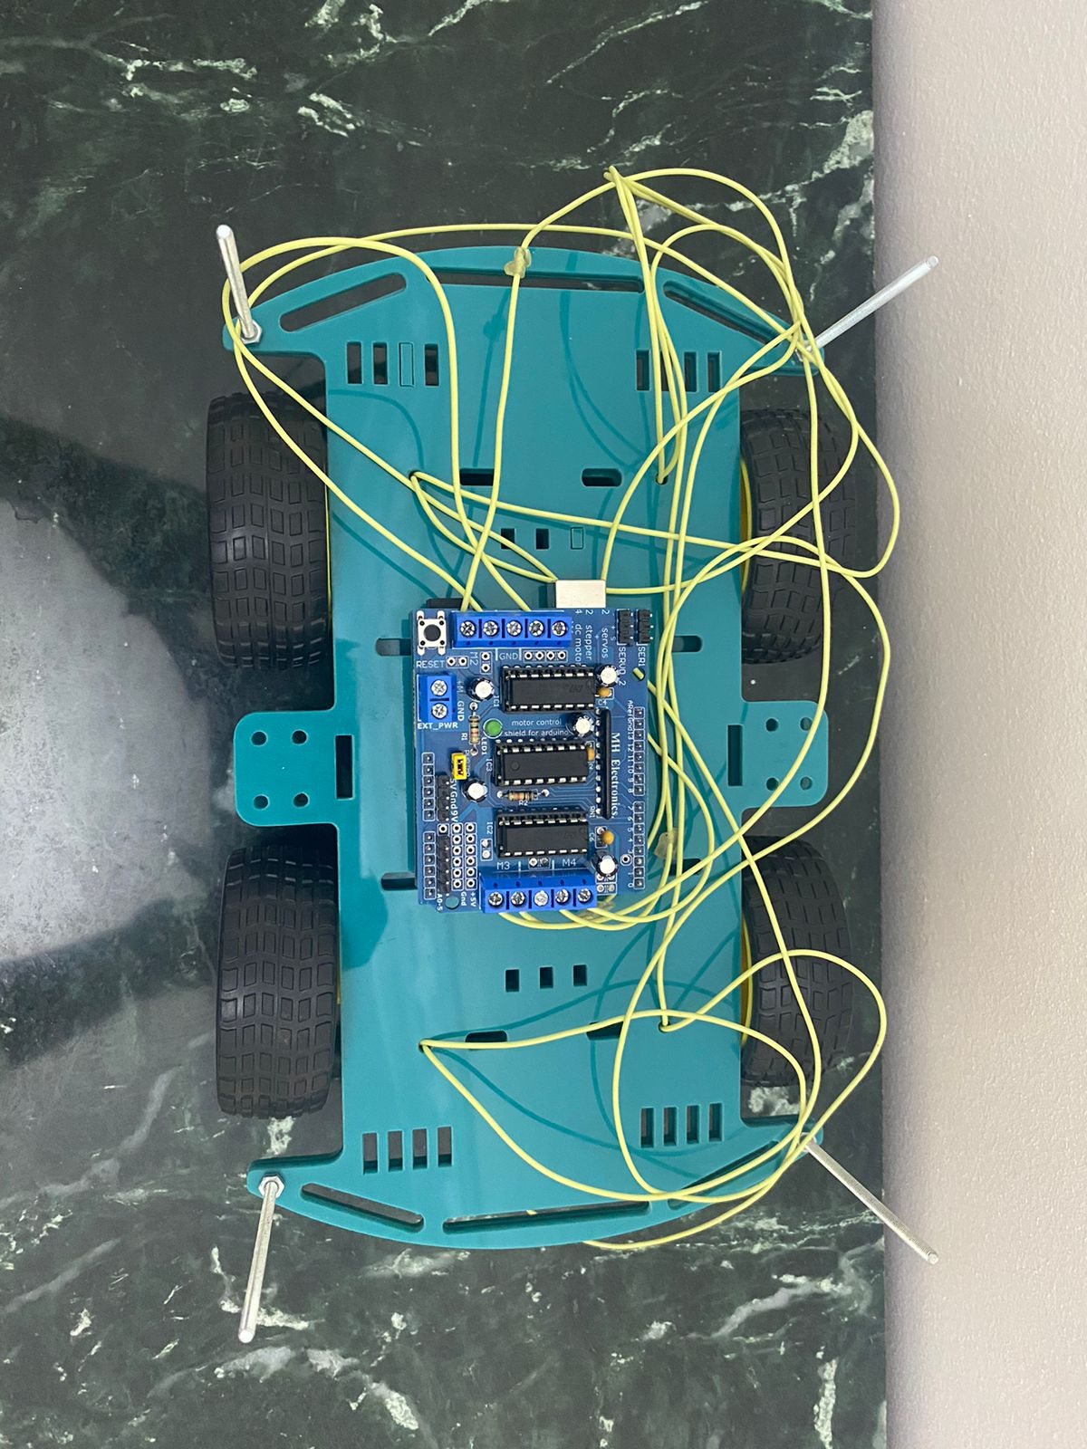
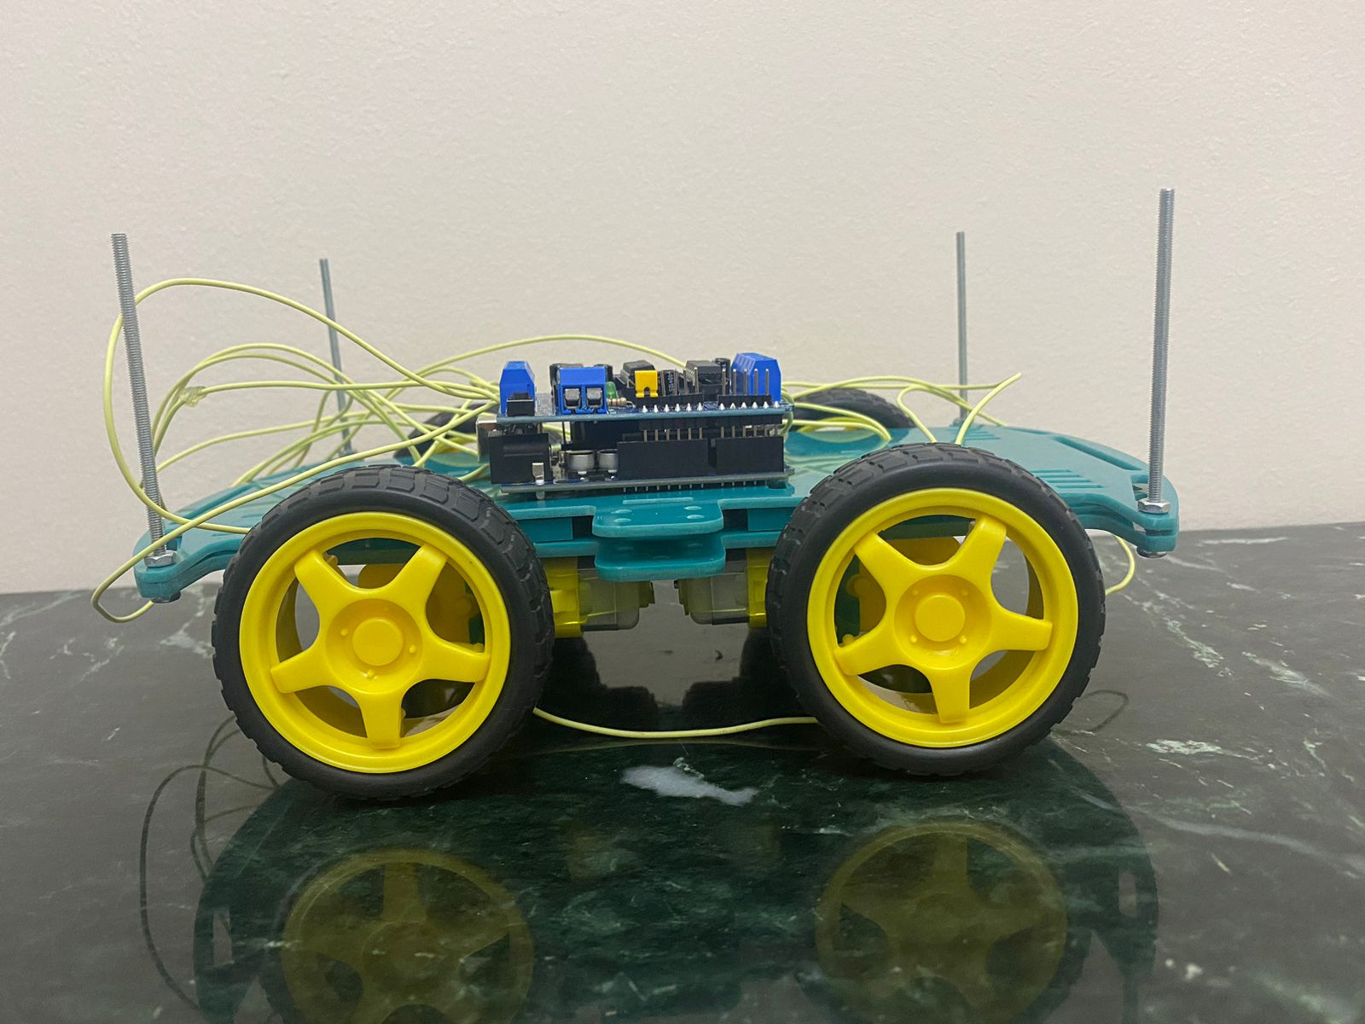
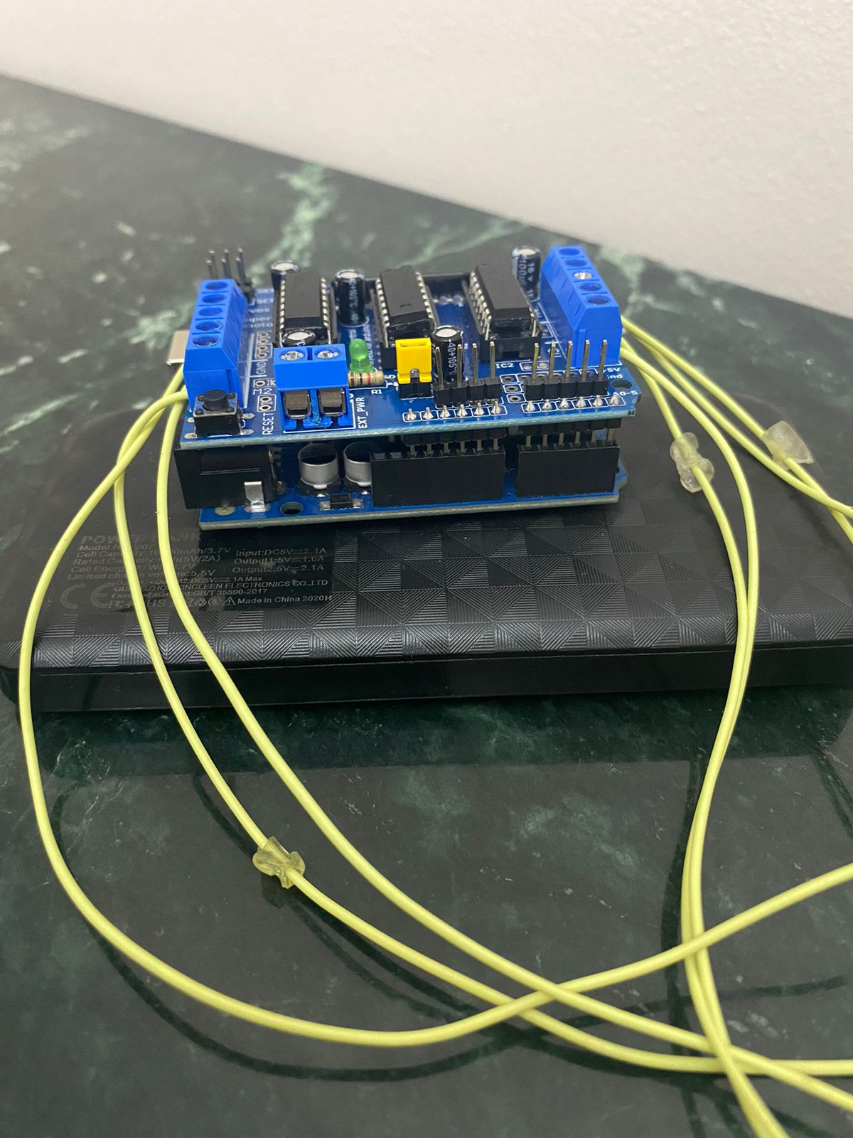
The primary algorithms used in the code can be summarized as:
Obstacle Detection and Avoidance: Continuously checks for obstacles and makes decisions to avoid collisions.
Distance Measurement: Uses the ultrasonic sensor to measure distances and determines if there is an obstacle.
Movement Control:
Gradual Speed Increase: Gradually increases the motor speed to the desired level.
Directional Turning: Controls the direction of the car by turning right or left.
Servo Positioning: Positions the servo to look right or left and measure distances to aid in decision-making.
These algorithms work together to enable the car to navigate its environment autonomously, avoiding obstacles and making decisions to move in the safest direction.
Code Implementation summary

Slide 23
Students
Zeinab Mohamed
Basmala Akram
Henar ElSayed
2103159
2103131
20221310251
Bassant Mohamed
Noha Nael
Nureen Ehab
20221376715
2103130
20221465124

